Slide 1
Azure Community Conference 2021

Slide 2



Gold Partner
Venue Partner
Learning Partner

Slide 3

HEMAPRIYA N
Data Engineer & AI Enthusiast
WTM Ambassador & GDG Organizer
Developer at the core

Slide 4

Adventure into Computational Linguistics : Exploring the wonders of Language Models

Slide 5
THE COMMON BUZZ QUESTION !!!

Slide 6
THE COMMON BUZZ QUESTION !!!
WHAT IS AI ?

Slide 7
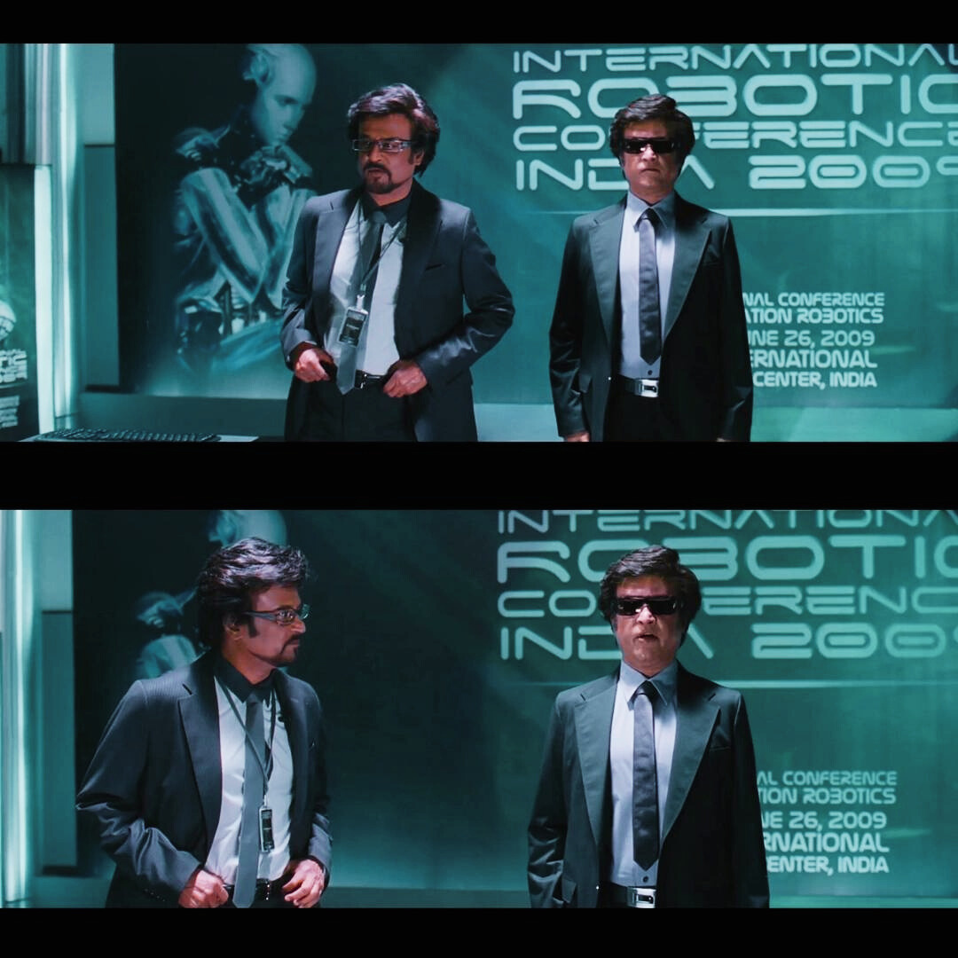



ARTIFICIAL NARROW INTELLIGENCE
Known as Weak AI , used to perform specific task that doesn’t require intense understanding

Slide 8

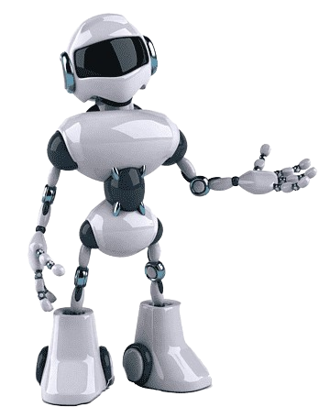


ARTIFICIAL GENERAL INTELLIGENCE
Known as Strong AI , that can perform any intellectual task, with human-like intelligence & ability to learn

Slide 9

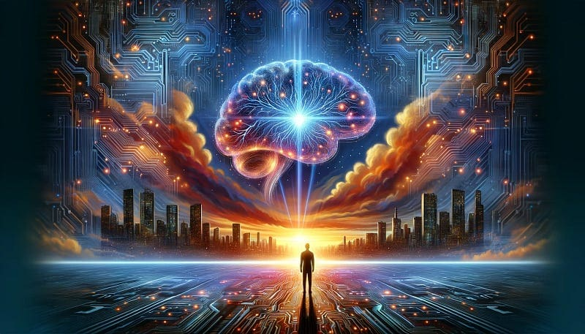
ARTIFICIAL SUPER INTELLIGENCE
Refers to the time when the capability of computers will surpass the humans with
cutting-edge cognitive functions

Slide 10

LET’S DECODE !!!

Slide 11
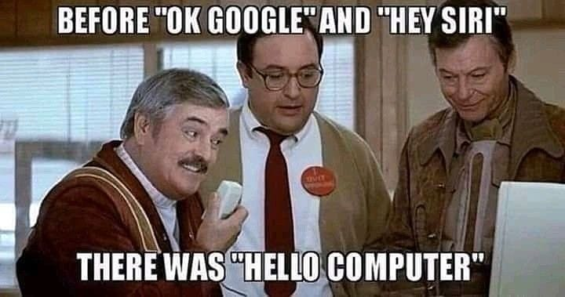
HELLO WORLD !!!

Slide 12
WHY UNDERSTANDING NATURAL LANGUAGE ?
Machine Translation
Computational Power
Linguistic theories & framework
Corpora & Data Availability
Advances in ML & AI
Practical Applications
Open-source communities

Slide 13


Slide 14

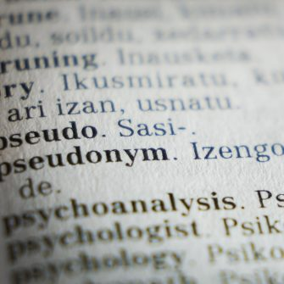
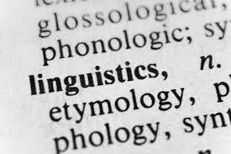
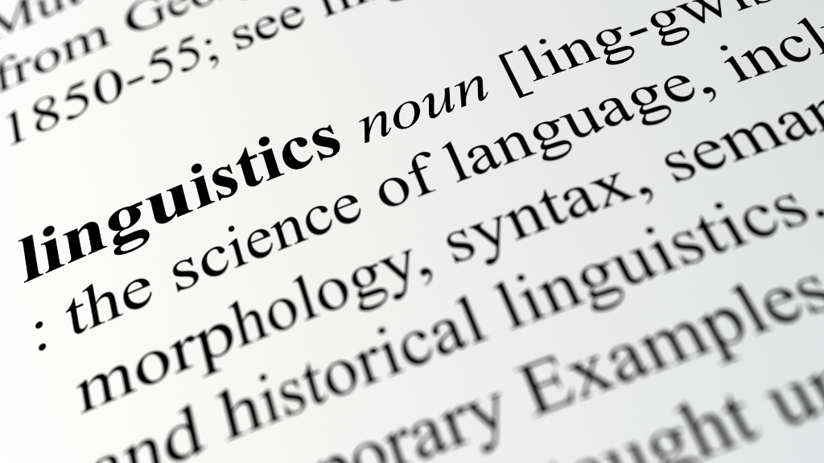
COMPUTATIONAL LINGUISTICS
👉🏻 Make computers understand human language
👉🏻 Use technology to process or produce human language
👉🏻 GOAL – Communicate with computers in the language we speak !!

Slide 15
When do you think the first chatbot was developed ?

Slide 16

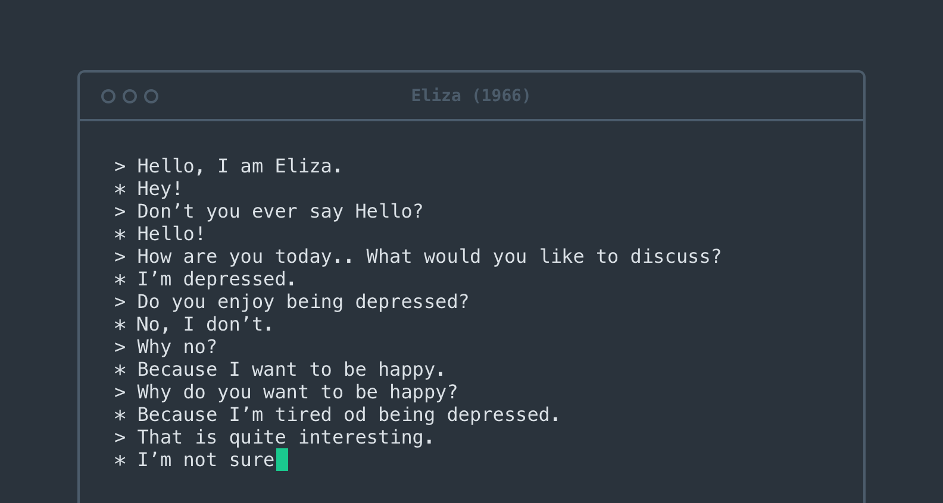
ELIZA, THE THERAPIST
- Bot based on pattern matching
- Directives given in scripts
- Coded with MAD
- Rule book – DOCTOR Script
Indeed ,the precursor Galentine for Alexa and SIRI ⭐
Notes:
MAD (Michigan Algorithm Decoder)

Slide 17



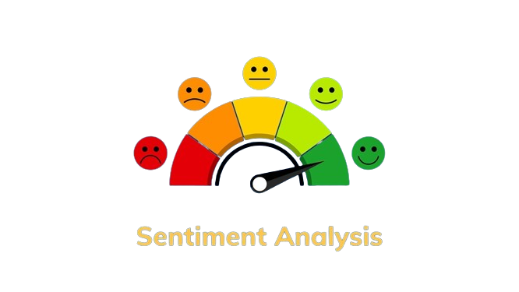

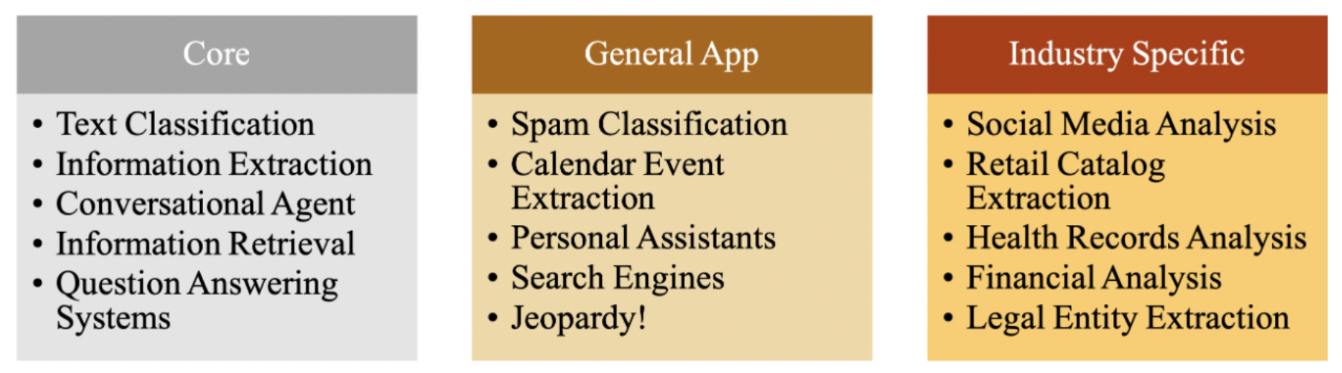
CL (AKA) NLP IN DAILY LIFE
Notes:
Machine transaltion
Sentiment analysis
Content filtration
Chatbots
Knowledge extraction

Slide 18
CL vs NLP
COMPUTATIONAL LINGUISTICS
You are a linguist
You help computers to study & understand languages
NATURAL LANGUAGE PROCESSING
You are a Computer scientist / Engineer
You develop / work on applications involving language
Aren’t they synonymous ?
Notes:
TALK ABOUT NLP, NLU, NL

Slide 19
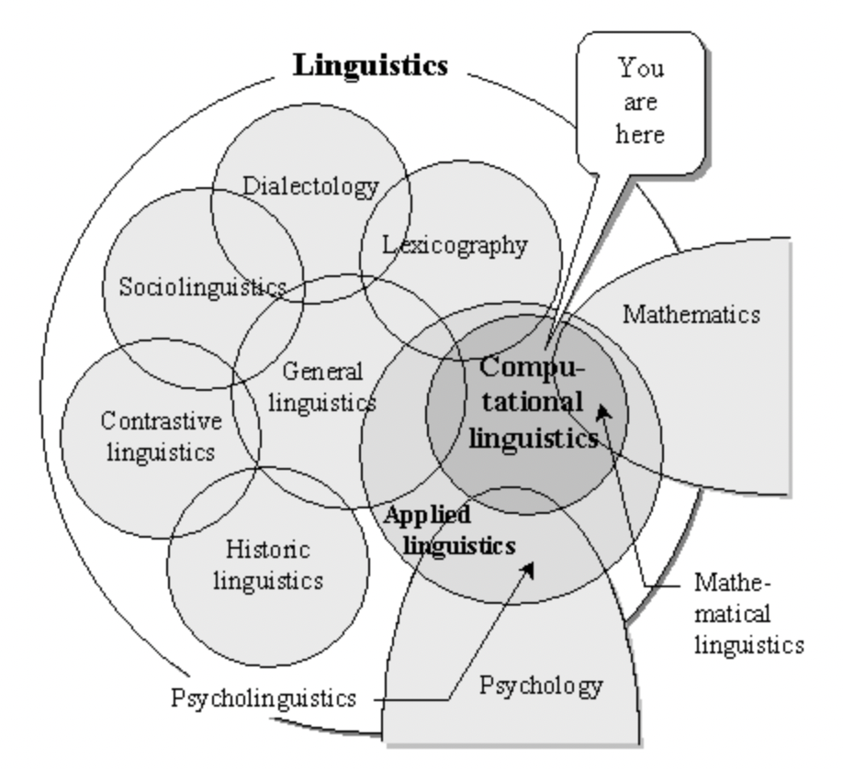
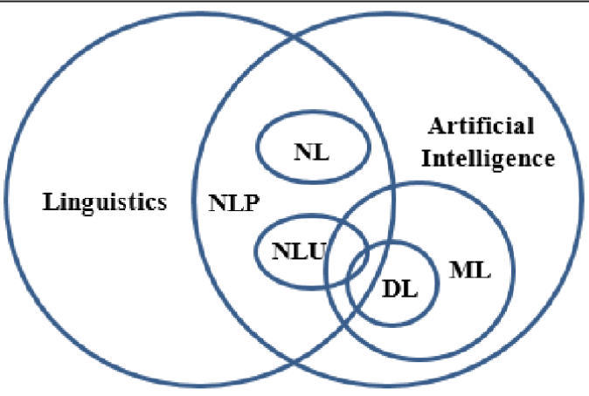
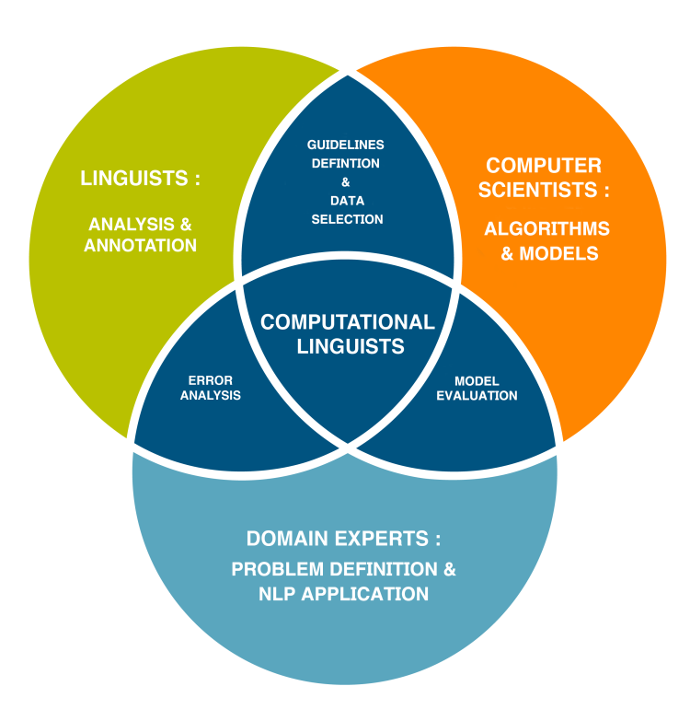
INTERDISCIPLINARY INDEED !!!
Notes:
Semantics: The study of the meaning of words, phrases, and sentences in a language. It focuses on understanding the relationships between words and their meanings within a linguistic context.
Lexical Analysis:
Lexicon: The vocabulary or dictionary of a language, including words and their meanings. Lexical analysis involves identifying and processing individual words in a text, including tokenization, stemming, lemmatization, and morphological analysis.
Pragmatics:
Pragmatics: The study of how context influences the interpretation of language. It deals with the intended meaning of utterances in specific situations and the impact of factors such as tone, context, and speaker intention on communication.
Discourse Analysis:
Discourse: The study of extended stretches of language, such as conversations, texts, and narratives, beyond the level of individual sentences. Discourse analysis examines how language is used to convey meaning, structure information, and achieve communicative goals within larger contexts.
Morphology:
Morphology: The study of the internal structure and formation of words. It deals with the analysis of word forms, including inflectional and derivational morphology, and how words are composed of smaller meaningful units called morphemes.

Slide 20
INCEPTION TO INNOVATION
Corpus & Text-based systems
Contextual
understanding
LLMs & Scaling
human-like data
1960s
1990s
2005s
2017s
2019
2020s
2024 & beyond !!
1960s
1990s
2005s
2017
2019
2020s
Rule based system &
Pattern matching
Understanding core
Natural language
BERT & GPT
Human language generation

Slide 21

LET’S GET INTO NLP
NLP is an intersection of computer science, linguistics and machine learning
It is all about making computers understand and generate human language

Slide 22
THE SUBSETS !!
Artificial Intelligence
Machine Learning
Deep Learning

Slide 23
THE SUBSETS !!
AI
NLP
DL
ML

Slide 24

DECODING NLP

Slide 25
DECODING NLP
How computers understand text?
Assume you have a text. Let’s see how to break it down to train a model !!
TEXT: “Welcome to Global Azure 2024”

Slide 26
DECODING NLP – TEXT PRE-PROCESSING - I
TOKENIZATION
LEMMATIZING
Breaks the raw text into words, sentences called tokens
Reduces the word to its base or canonical form called lemma
STOP WORDS
STEMMING
Commonly used words that can be eliminated in a language
Understanding the word form by simplifying it
to the root word

Slide 27
DECODING NLP – TEXT PRE-PROCESSING - I
“Welcome to Global Azure 2024. This is going be an amazing experience”
TOKENIZATION
[ Welcome, to, Global, Azure, 2024, This, is, going, be, an, amazing, experience ]

Slide 28
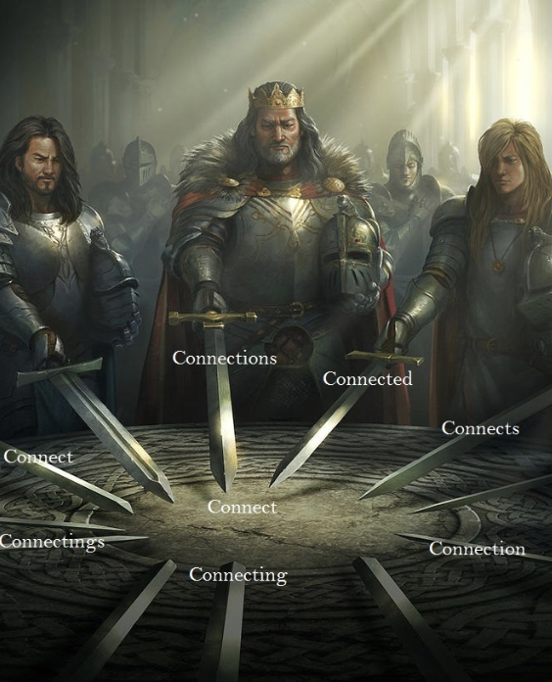
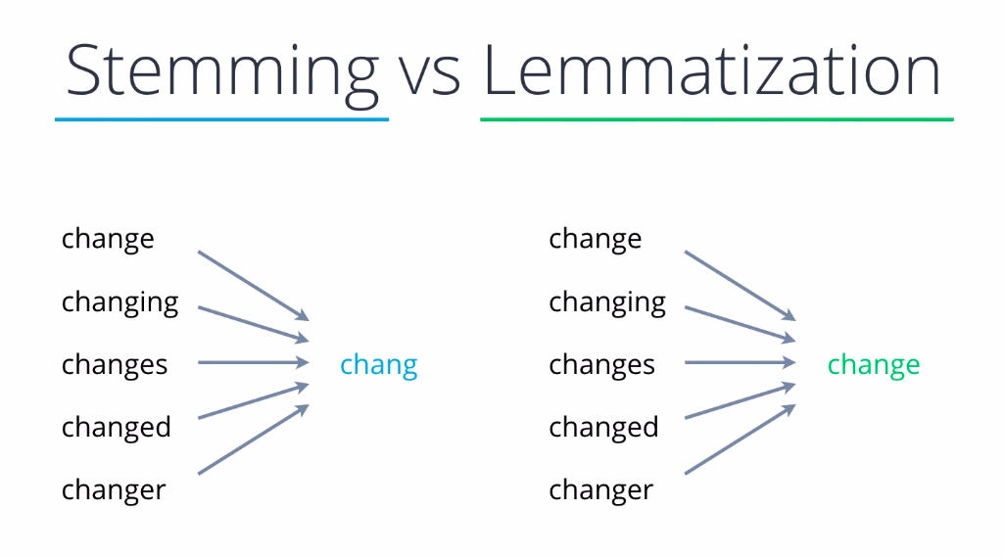
DECODING NLP – TEXT PRE-PROCESSING - I

Slide 29
DECODING NLP – TEXT PRE-PROCESSING - I
“Welcome to Global Azure 2024. This is going be an amazing experience”
STEMMING
“Welcom to Global Azure 2024. This is go be an amaz experience”

Slide 30
DECODING NLP – TEXT PRE-PROCESSING - I
“Welcome to Global Azure 2024. This is going be an amazing experience”
LEMMATIZING
“Welcome to Global Azure 2024. This is going be an amazing experience”

Slide 31
DECODING NLP – TEXT PRE-PROCESSING - I
“Welcome to Global Azure 2024. This is going be an amazing experience”
STOP WORDS
Welcome Global Azure 2024. amazing experience

Slide 32
DECODING NLP – TEXT PRE-PROCESSING - II
BAG OF WORDS
TF / IDF
A text , represented as multiset of words without grammar
Importance & relevancy of strings in a document in a huge corpus
N-GRAMS
Sequence of N- tokens
1 - gram – one-word sequence
2 - gram – two-word sequence
…
And so on

Slide 33
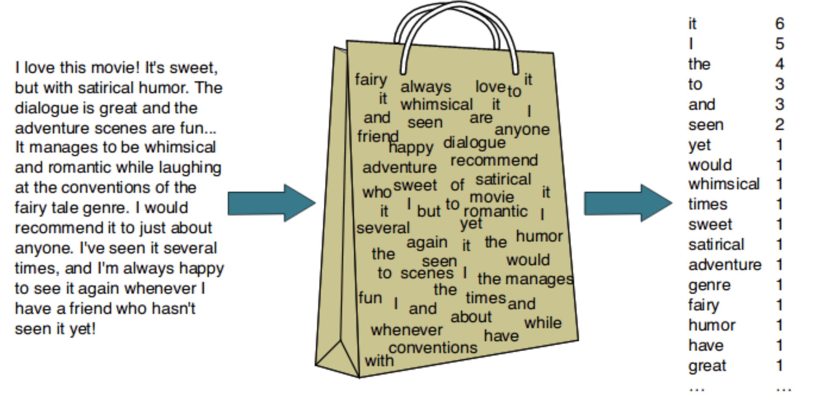
DECODING NLP – TEXT PRE-PROCESSING - II

Slide 34
DECODING NLP – TEXT PRE-PROCESSING - II
UNI GRAM
Welcome
to
Global
Azure
2024
BI GRAM
Welcome to
Global Azure
2024
TRI GRAM
Welcome to Global
Azure 2024

Slide 35
DECODING NLP – TEXT PRE-PROCESSING - II
Sentence 1 : The car is driven on the road
Sentence 2 : The truck is driven on the highway
Frequency of the term ‘t’ in document ‘d’
TF (Term Frequency)
=
Total terms in document ‘d’
Total number of documents
IDF(Inverse Document Frequency)
Log₁₀
=
Documents with term ‘t’

Slide 36
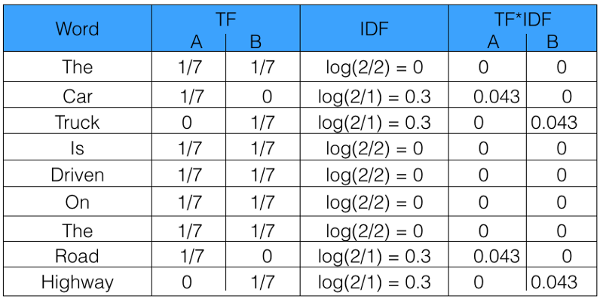
DECODING NLP – TEXT PRE-PROCESSING - II
Sentence 1 : The car is driven on the road
Sentence 2 : The truck is driven on the highway

Slide 37
DECODING NLP - VECTORS - III
Mathematical representation of words
Represented in an array , where the array elements represent a feature or dimension
Combination of elements shows the meaning or context of the word
EG : CAT – Features : [size, breed, behavior]
Representation: [0.2, 0.5, 0.8]

Slide 38
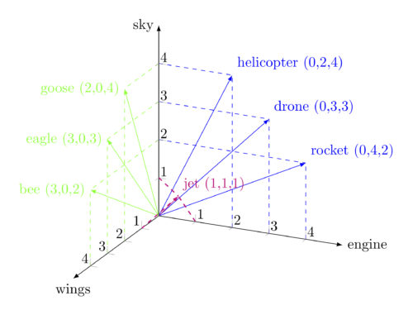
DECODING NLP - VECTORS - III
WORD2VEC – converts the words to 32 or more dimensional vectors by considering the semantics as well as the order of appearance.
CORPUS – [Bee, Eagle, Goose, Helicopter, Drone, Rocket, Jet]
CONTEXT – [Wings, Engine, Sky]
Eg : Bee – Wings & Sky – [3, 0, 2]
Drone – Engine & Sky – [0, 3, 3]
Goose - Wings & Sky – [2, 0, 4]

Slide 39

DECODING NLP - VECTORS - III

Slide 40
DECODING NLP – WORD EMBEDDINGS- IV
- Dense vector representation of words in a continuous vector space.
- The vectors are in turn used to represent the data points with contextual understanding and meaning.
- Pulls the semantic relationship between words and contextual information

Slide 41
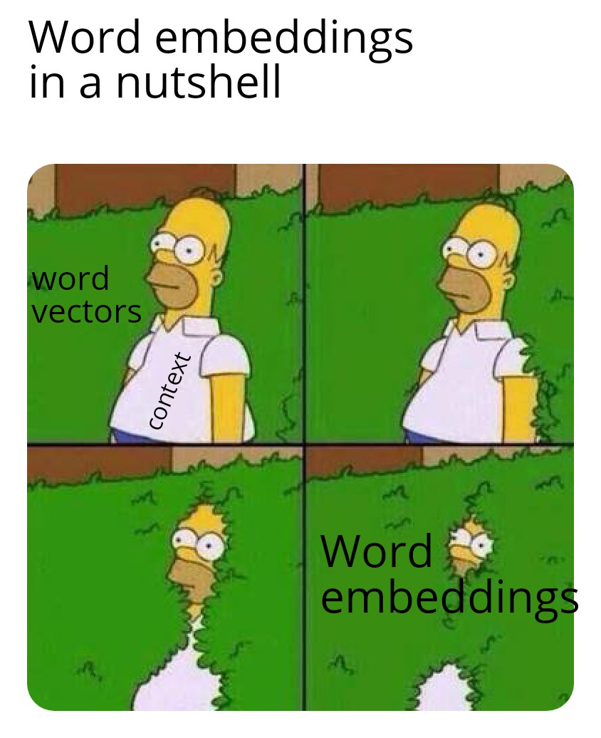
DECODING NLP – WORD EMBEDDINGS- IV

Slide 42
DECODING NLP – WORD EMBEDDINGS- IV
Sentence 1 : I like to eat apples
Sentence 2 : I like mangoes
Sentence 3 : I like eating oranges
ONE HOT ENCODING
Similarity index between sentences
1 & 2 : [1, 1, 0, 0, 0]
1 & 3 : [1, 1, 0, 0 ,0]
2 & 3 : [1, 1, 0, 0]

Slide 43
JUST IMAGINE !!!
Corpus with 10,000 sentences
400 features to be considered
How to construct the embeddings now ?

Slide 44
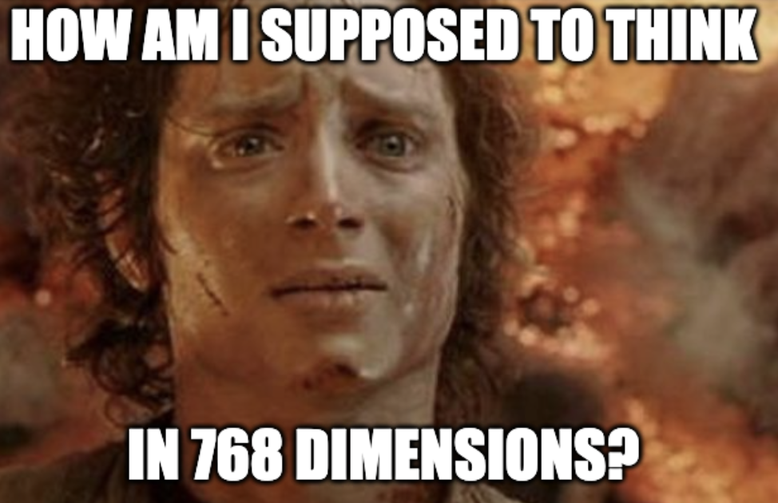
DECODING NLP – WORD EMBEDDINGS- IV

Slide 45
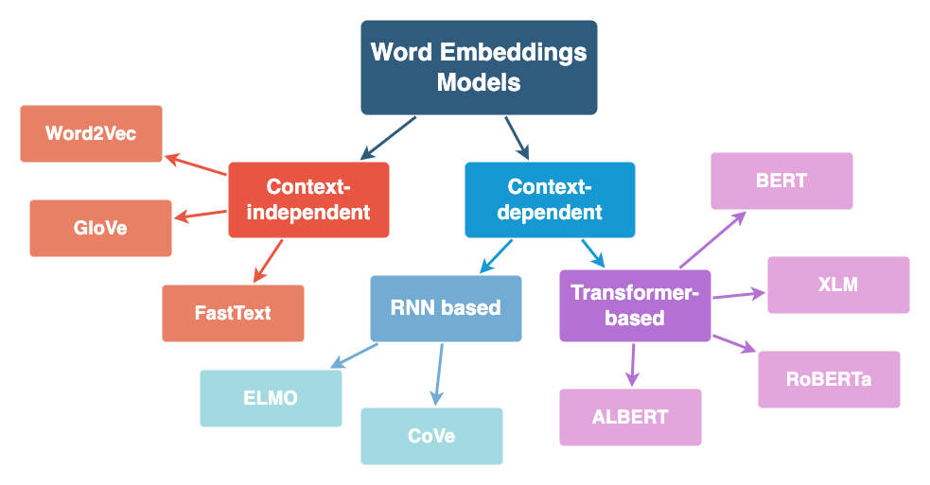
DECODING NLP – WORD EMBEDDINGS- IV

Slide 46

GAME TIME !!!

Slide 47
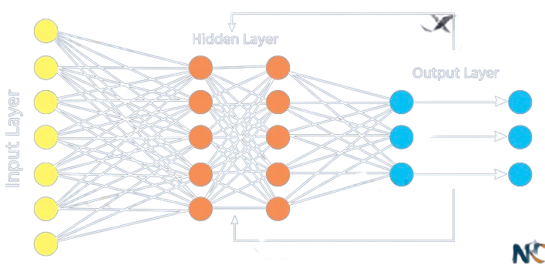

DECODING NLP - RNNs - V
RNNs & Sequential Data – indeed a great match !
RNNs maintain memory of previous inputs as they process each word in a sequence.
RNNs can process the sequence of embeddings to obtain the context.
Contextual dependencies are thus preserved
Well suited for tasks to predict next tokens based on previous words

Slide 48
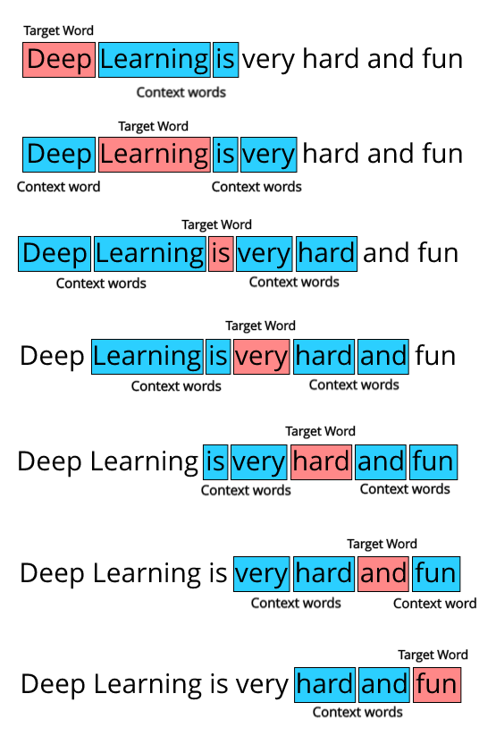
DECODING NLP – RNNs- V
Word embeddings + RNN
NLP can leverage both
the semantic information captured by embeddings
&
sequential dependencies captured by RNNs
Tasks : Language Modelling, Machine Translation, Sentiment analysis & ….

Slide 49
DECODING NLP – LSTMs- VI
STEP 1: To decide what to hold and what to forget
STEP 2 : What new information to add
STEP 3: Update the cell state with information from step 1 & step 2
STEP 4: Focus on the output

Slide 50
DECODING NLP – LSTMs- VI
MEMORY CELL
Temporarily remembers and forgets the vectors
INPUT GATE
Y = WX + B where X acts as input to hidden layer along with added info to memory cell
FORGET GATE
When context changes, the output vector changes, and previous vector will be forgotten
OUTPUT GATE
All information from memory cell is carried to output layer (ie)
Memory + Weights

Slide 51
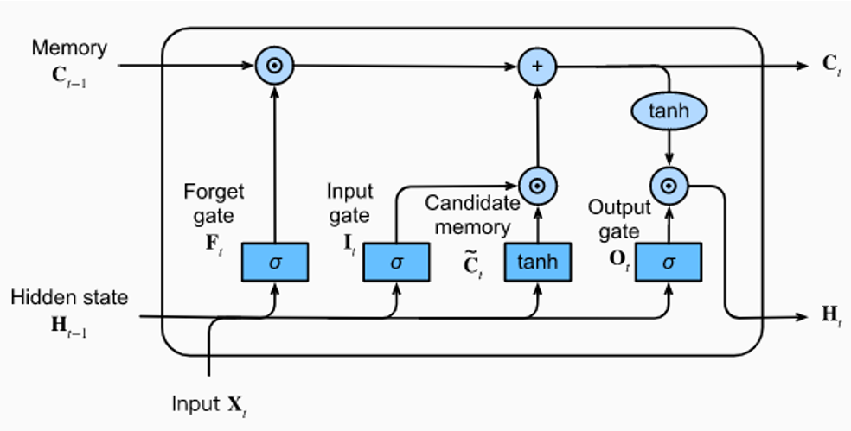
DECODING NLP – LSTMs- VI

Slide 52
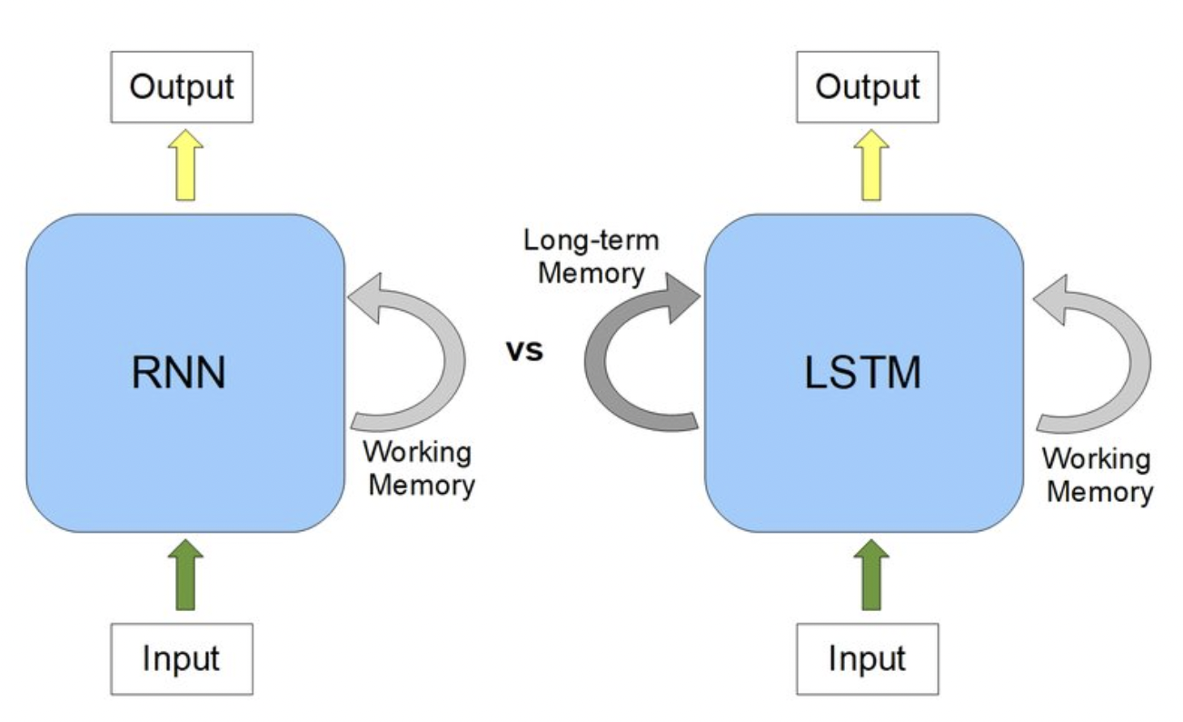
DECODING NLP – RNN vs LSTMs - VI
Long range dependencies in sequential data
Gating mechanism in LSTMs provide better gradient flow
Memory cells are adaptable

Slide 53
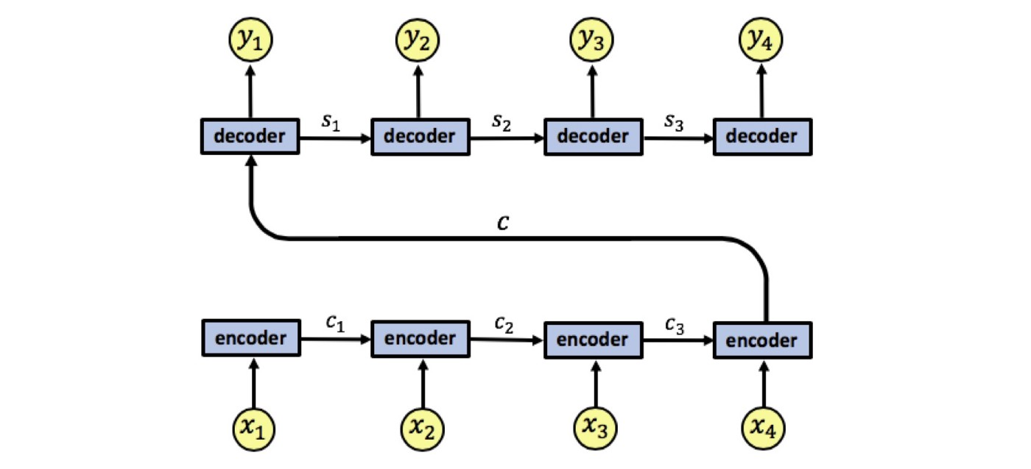
DECODING NLP – ENCODER & DECODER - VII
OUTPUT
Encoder summarizes and preserves the input sequence of information in the internal state vectors
Decoder (LSTM Cell) starts generating output sequences based on final state of encoder LSTM
STATE
ENCODER
DECODER
INPUT
Notes:
Thought vectors

Slide 54
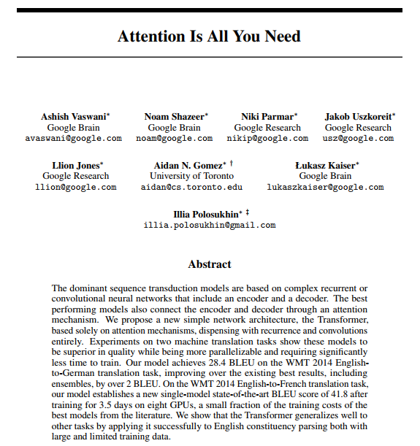
DECODING NLP – ATTENTION - VIII
WHY ATTENTION MODELS?
All information is sourced into fixed-length vector
Decoder has more load to decipher huge single vector
Issues with handling long sentences – length more than in corpus
Compressing huge information in a vector is quite not adaptable

Slide 55
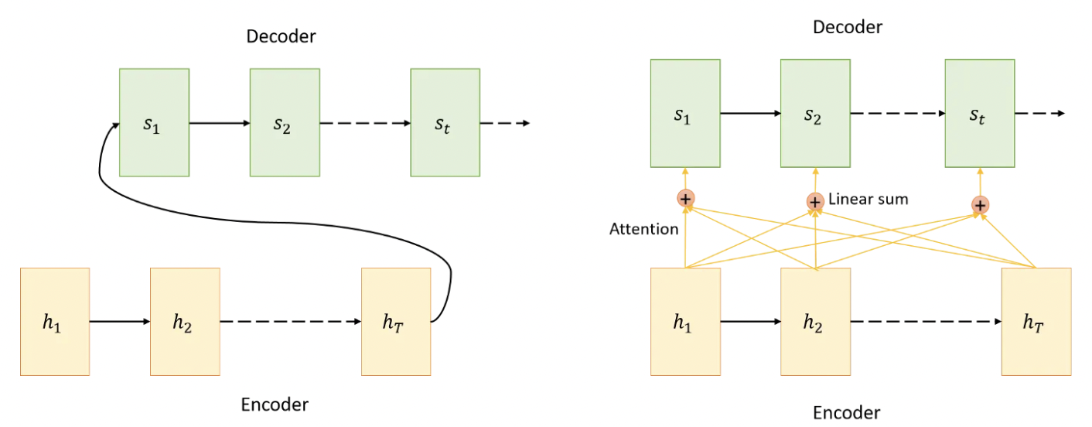
DECODING NLP – ATTENTION - VIII
Encoding
Computing Attention weights
Context vector
Decoding

Slide 56

DECODING NLP – TRANSFORMERS - IX
Transformers leverage self-attention mechanism
Enables parallelization during training
Improved performance
Models such as BERT & GPT showed the effectiveness of transformer-based
architectures

Slide 57
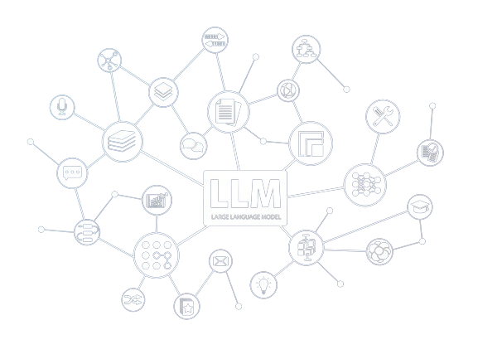
DECODING NLP – LLMs - X
Models trained on vast data and process billions of parameters
Understands and generates human-like text across wide topics & domains
Common reasoning & language understanding
Generalization & Versatility

Slide 58
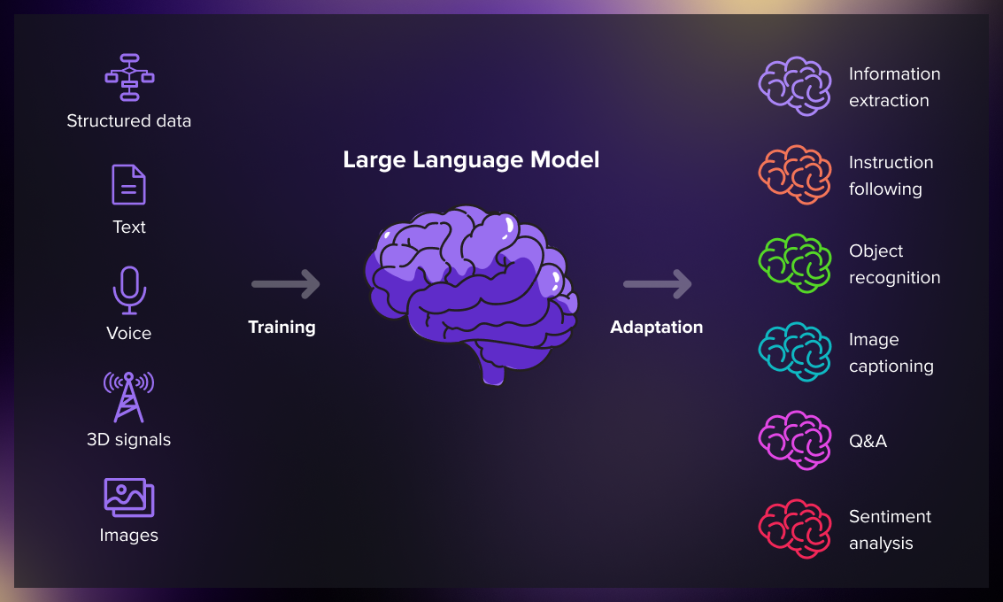
DECODING NLP – LLMs - X

Slide 59

GENERATIVE AI & LLMs

Slide 60
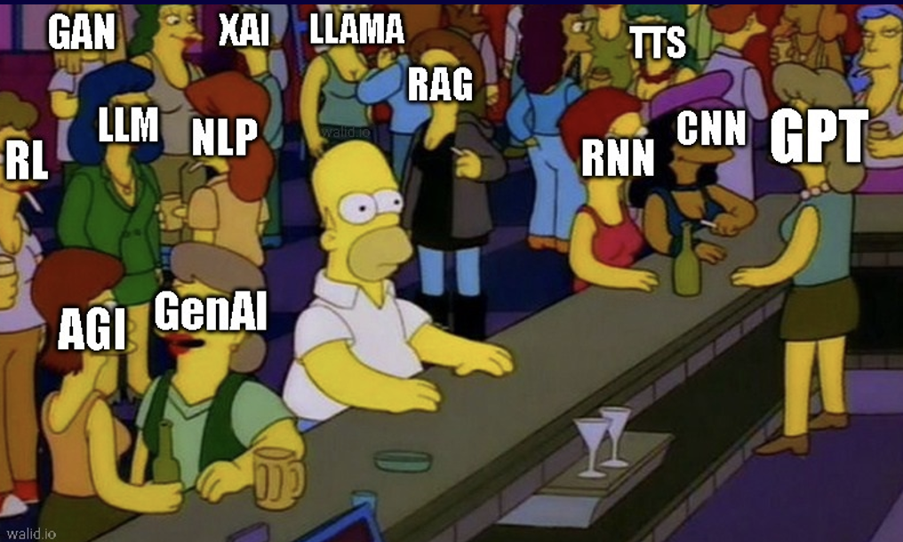

Slide 61

* LLMs

Slide 62





THE LOGO QUEST

Slide 63

LLMs !!
GPT 2 – State-of-art -language model
BERT – Bidirectional Encoder Representations from Transformers
GPT3 – Decoder-only Transformer model
LLAMA 3 – Decoder-only multimodal Transformer architecture
Megatron LLM

Slide 64
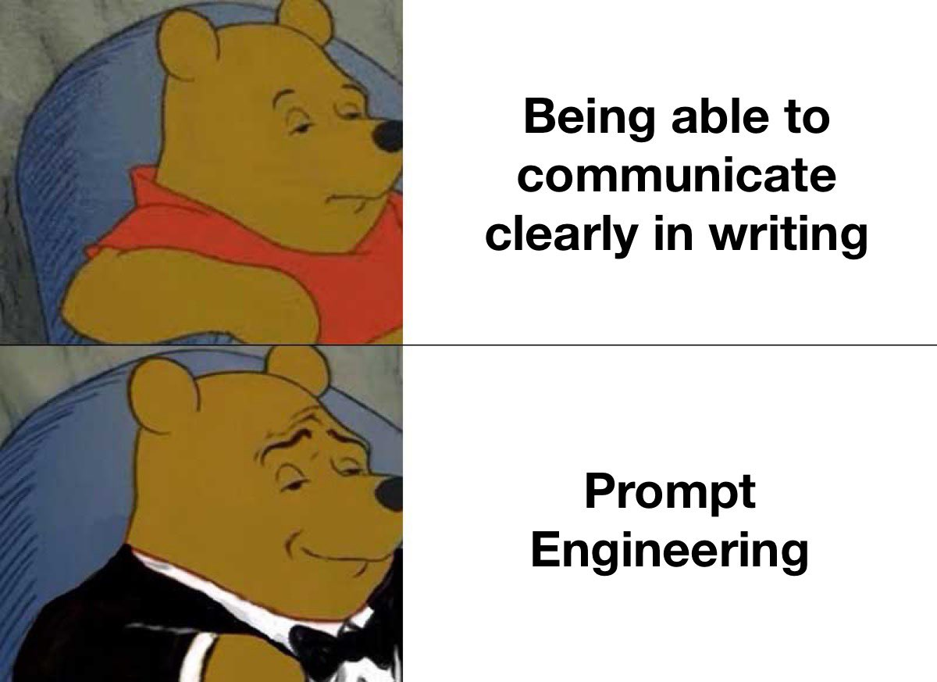
PROMPT ENGINEERING
Prompting involves defining clear and concise steps for the AI models to guide the responses and actions

Slide 65
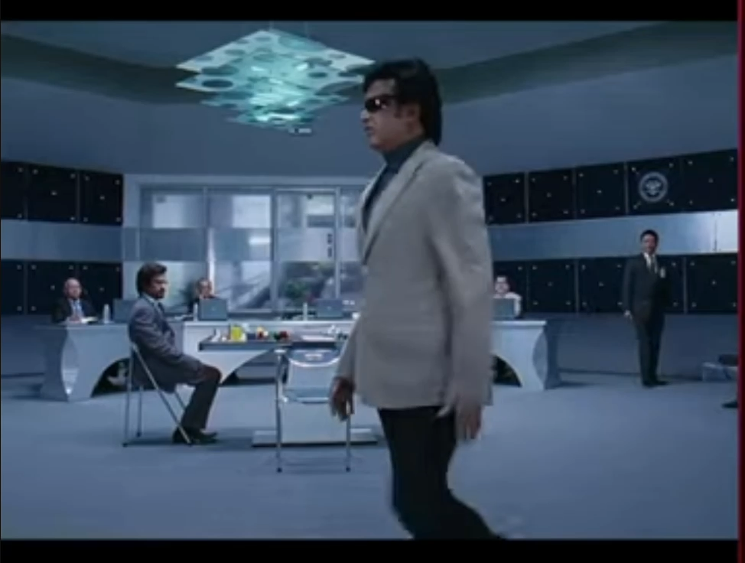
PROMPT ENGINEERING

Slide 66
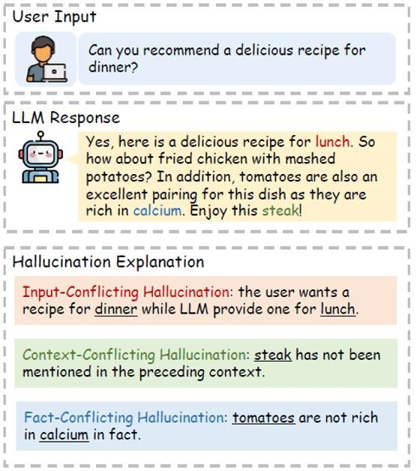
HALLUCINATION
Generation of inaccurate ,
non-sensical, detached text that poses a risk when using these models

Slide 67
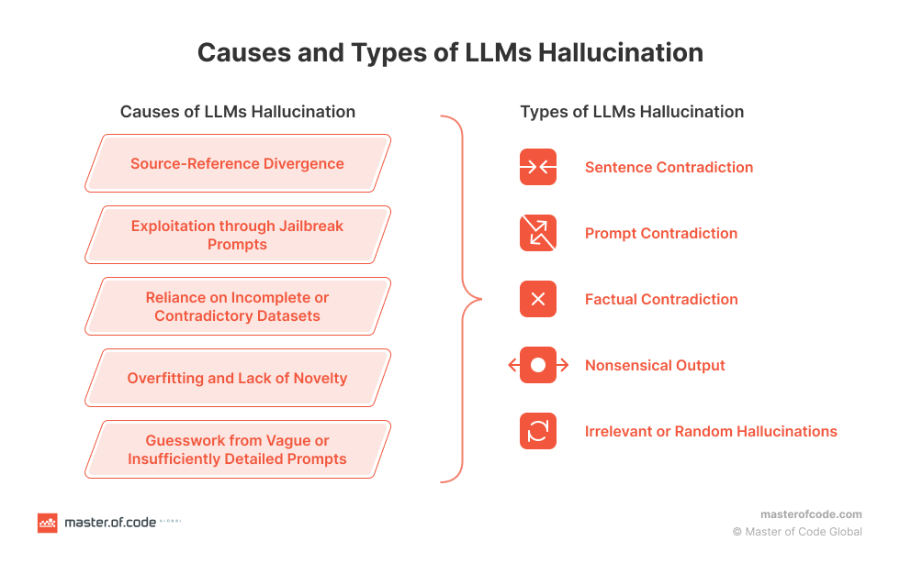
HALLUCINATION

Slide 68

RAGs
QUESTION
RAG Framework combines Retrieval and Generative models in NLP to enhance the response generation process by providing access to Knowledge Base
RETRIEVER
GENERATOR
RESPONSE
KNOWLEDGE BASE
[ VECTOR DB ]

Slide 69
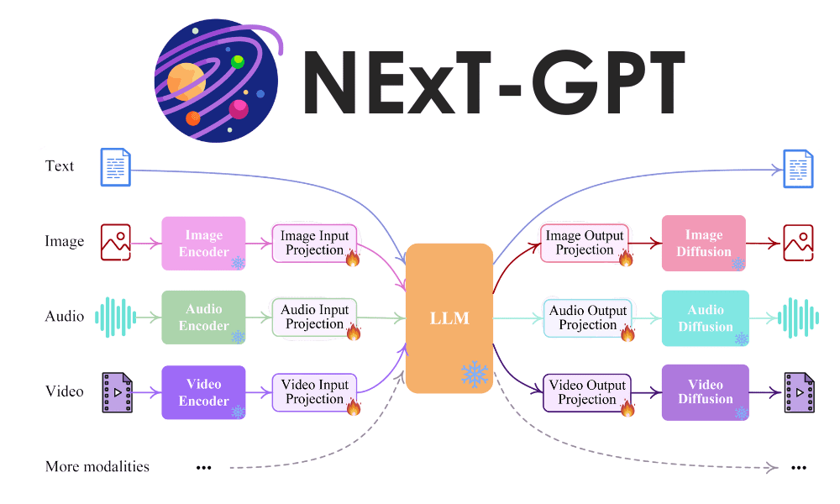
LMMs

Slide 70
GEN AI IMPLEMENTATION
Pre-trained models via APIs
Utilizing Foundation Models /Open –sourced LLMs
Fine-tuning models for custom data and specific use-case

Slide 71


BUILD YOUR OWN LLM
Tokenization
Define Your Objective
Remove Special Char
Gather and Preprocess Data
Lowercasing
Model Structure
Choose a Model Architecture
out-of-vocabulary
Forward Pass
Build the Model
Loss Functions
Hyperparameter Tuning
Set Up Optimization
Text Generation
Train The Model
Evaluation and Fine-Tuning
Deployment
Continuous Improvement

Slide 72



BUILDING LLMs
HOSTING
Service providers
Expose as API
Huggingface
Cloud
MODELS
ORCHESTRATION
Hugging face
OpenAI
META
Gemini
LLamaIndex
Langchain

Slide 73



BUILDING LLMs
HOSTING
DATA SOURCES
VECTOR DBs
Service providers
Expose as API
Huggingface
Cloud
FAISS
Chroma
Pinecone
Structured
Unstructured
Multi-media
PIPELINES
MODELS
ORCHESTRATION
Airflow
Databricks
Azure
GCP
Hugging face
OpenAI
META
Gemini
FRAMEWORKS
LLamaIndex
Langchain
Pytorch
Tensorflow
MosaicML

Slide 74
LLMs & NEXT STEPS !!!
ADAPTATION
FINE TUNING
Active learning
Retraining - Model inference
Data Augmentation
Prompt Tuning
PEFT
Adversarial Training
PRIVATE LLMs
Data Privacy
Compliance
Responsible AI
Customization

Slide 75
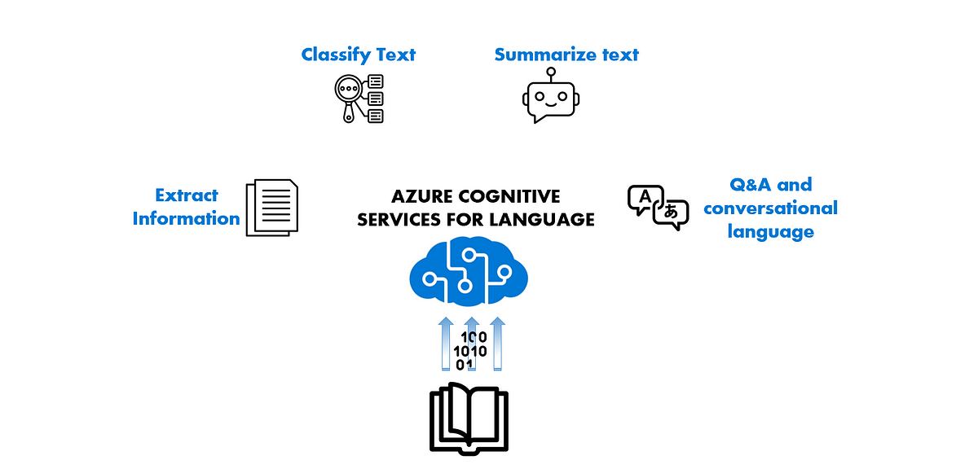
AZURE CAPABILITIES

Slide 76
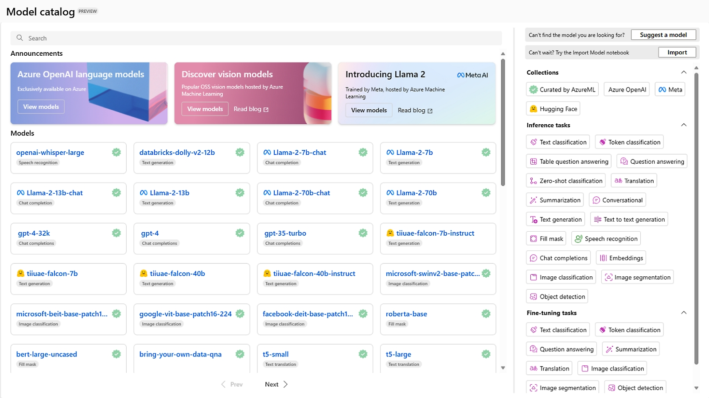
AZURE CAPABILITIES

Slide 77
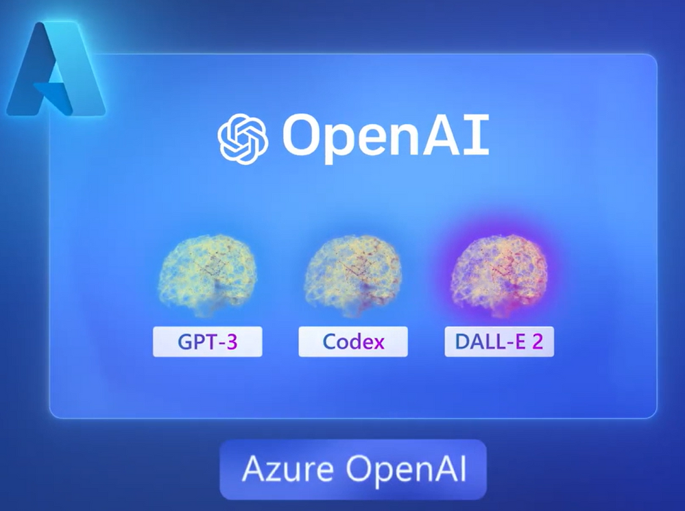
AZURE CAPABILITIES

Slide 78
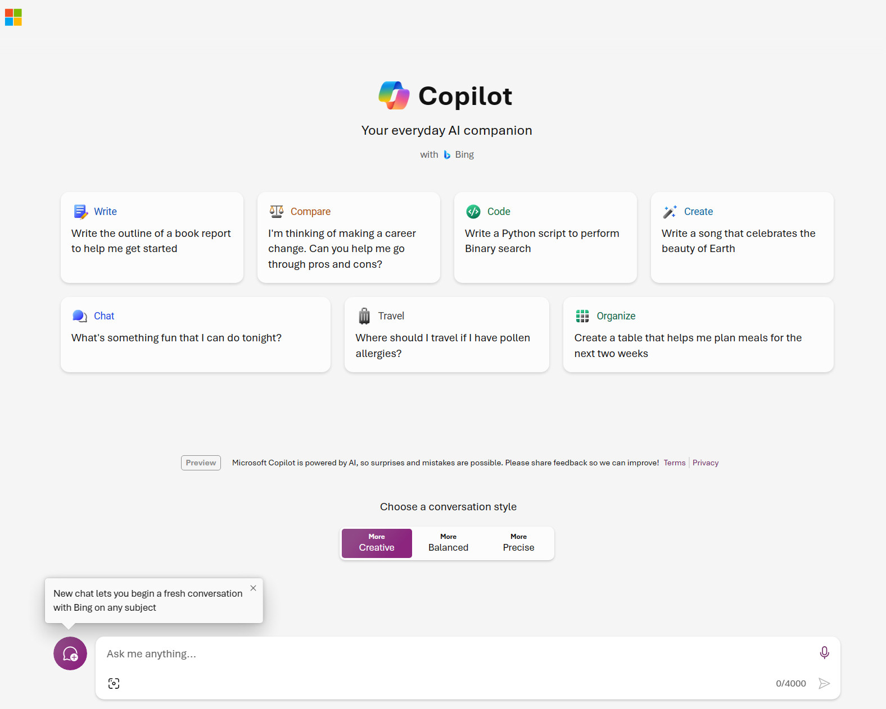
AZURE CAPABILITIES

Slide 79


Slide 80


LET’S AI IT
HUGE BYTES OF GRATITUDE Y’ALL !!

Slide 81



HEMAPRIYA N
Let’s connect !!

Slide 82


